Slide 1




Customer Segmantation using Excel
STUDENT NAME : E.Sri Ramajayam
REGISTER NO : 422200023
DEPARTMENT : B.COM[ISM]
COLLEGE : S.I.V.E.T COLLEGE

Slide 2
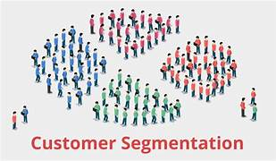
Customer Segmantation using Excel

Slide 3


AGENDA
Problem Statement
Project Overview
End Users
Our Solution and Proposition
Dataset Description
Modelling Approach
Results and Discussion
Conclusion
3/21/2024 Annual Review

Slide 4

PROBLEM STATEMENT
Customer segmentation is the process of examining customer attributes and creating groups based on how they behave, who they are, and their specific characteristics. Customer segmentation allows businesses to use targeted messaging, rather than taking a one-size-fits-all approach, to drive business results.
Gather as many insights as possible throughout your business development journey to understand customers and deliver the highest level of service.
Use the process below as a guide for developing a robust customer segmentation strategy.

Slide 5

PROJECT OVERVIEW
The first goal of this project is to analyze demographics data for customers of a mail-order sales company in Germany, comparing it against demographics information for the general population. The purpose is to find simillar characteristics in both groups, signaling good candidates, among the general population, for a marketing campaign.
The second goal is to develop a machine learning model that can classify new samples as good or bad candidates for a marketing campaingn using the demographic information from each individual.

Slide 6

WHO ARE THE END USERS?
User segmentation refers to those who interact with your product or service, including free trial users who are not yet customers. Customer segmentation refers to the companies or individuals (buyers) who decide to buy the product in the first place. In many cases, users and customers are the same.

Slide 7

OUR SOLUTION AND ITS VALUE PROPOSITION
Customer segmentation is the process of splitting your entire customer base into smaller segments based on shared characteristics. These can include demographics, behavioral, geographical, or psychographic data. When done correctly, customer segmentation helps you better understand users' needs and adjust your offering to satisfy them.

Slide 8
Dataset Description
Customer segmentation is the process of identifying common attributes/characteristics of customers and grouping them into specific buckets.
That allows you to be more strategic about which customer groups you focus on to fuel business growth or how to optimize your product experience for particular customer segments.
Customers have different needs and pain points, come from different walks of life, and ultimately experience your product differently. A solid customer segmentation strategy helps companies improve experiences and drive stronger conversion.

Slide 9
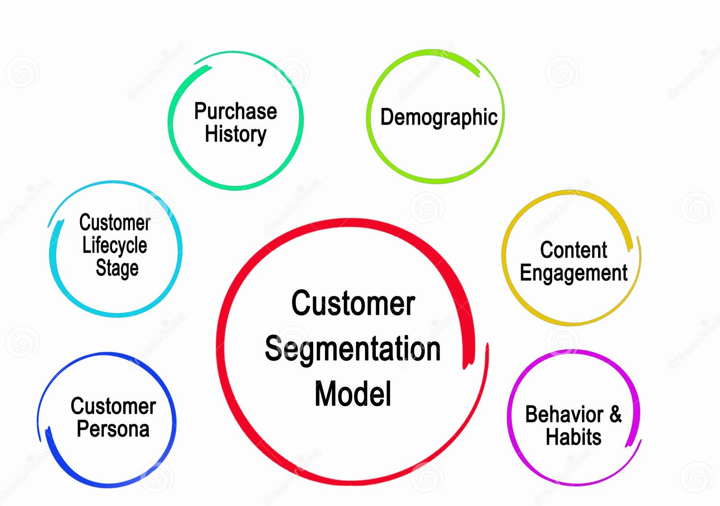
THE "WOW" IN OUR SOLUTION
3/21/2024 Annual Review

Slide 10
MODELLING
Demographic segmentation. Demographic segmentation is the one you’re probably most familiar with. This customer segmentation model separates customers by
Behavioral segmentation. With behavioral segmentation, you can separate customers by how they use your brand. For example, you can divide them by: How they use your products.
Psychographic segmentation. Psychographic segmentation is all about the inner feelings and attitudes your customers hold. It includes: Values. Interests. Attitudes.
Value-based segmentation. Value-based segmentation is all about the level of value your customer is offering you. With this customer segmentation model, you’ll measure your customer’s return on investment (ROI).

Slide 11
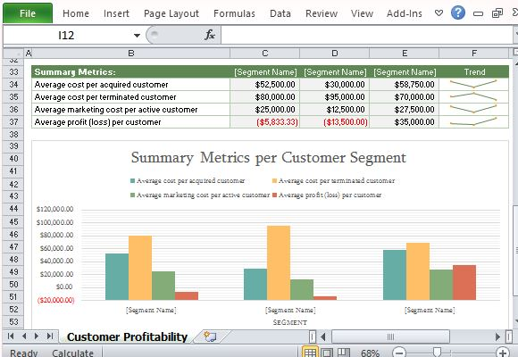
RESULTS

Slide 12
conclusion
A customer segmentation strategy is a systematic approach to building and analyzing customer segments while using tactics to achieve goals.
Customer segmentation is a very straightforward and logical method of understanding the customers that you interact with.

